Slide 1
Business Process Engineering
Week 04

Slide 2
Systems Applications and Information Flow in the Organization
Decisions
Management Levels
Information Systems
Unstructured
Senior Management
ESS
Strategic
DSS
Knowledge and Data Worker
GIS, CAD/CAM, OAS
Tactical
Middle
Management
MIS
Lower
Management
TPS
Technical
(Operational)
Buy
Make
Sell
Keep
Track
Functions
Structured

Slide 3
Data Characteristics
Data range refers to the amount of data from which information is extracted&
Time span refers to how long a period of time the data covers.
Level of detail is the degree to which the information generated is specific.
Internally or externally sourced.

Slide 4
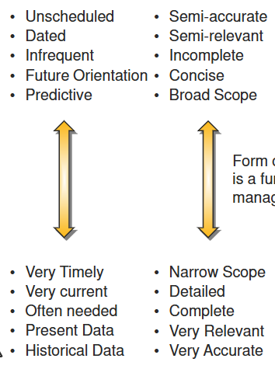
Information Need

Slide 5
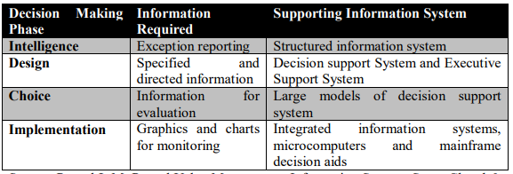
Decision Making Phase

Slide 6
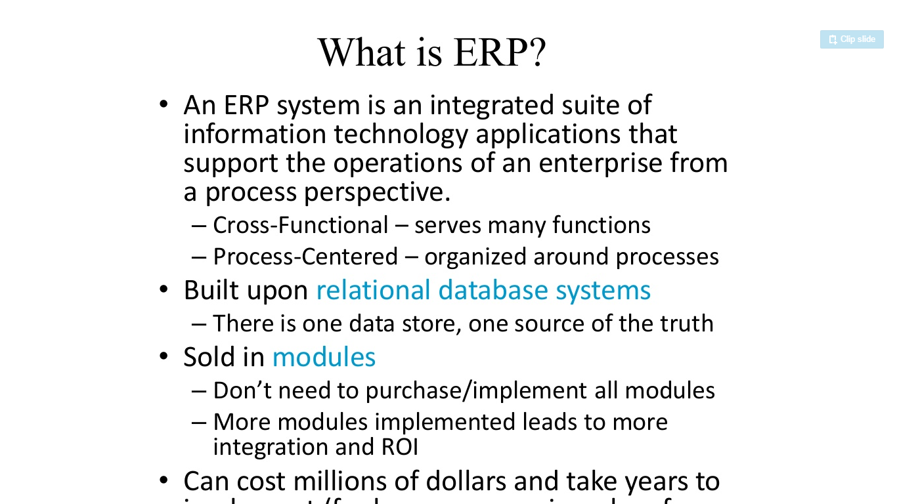
Enterprise Resource Planner

Slide 7
Enterprise Resource Planner

Slide 8
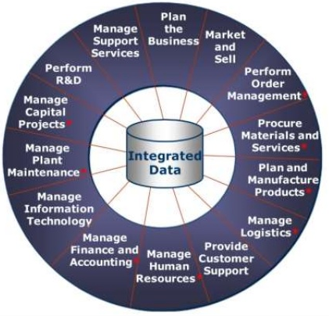

Slide 9
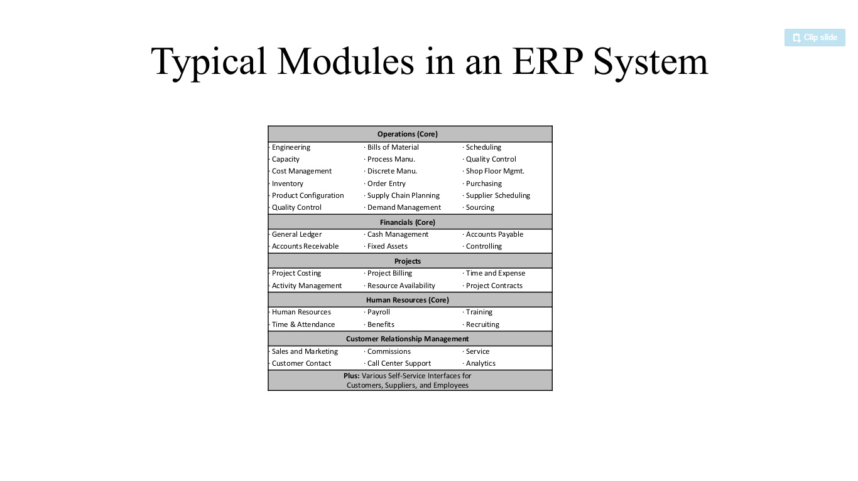
ERP Modules

Slide 10
Functional SAP ERP Modules
Human Capital Management (SAP HCM)
Production Planning (SAP PP)
Material Management (SAP MM)
Financial Supply Chain Management (SAP FSCM)
Sales and Distribution (SAP SD)
Project System (SAP PS)
Financial Accounting and Controlling (SAP FICO)
Plant Maintenance (SAP PM)
Quality Management (SAP QM)
Investment Management (SAP IM)

Slide 11
Technical SAP ERP Modules
SAP NetWeaver (formerly SAP Basis)
SAP EP (Enterprise Portal)
SAP PI (Process Integration)
SAP Solution Manager
Advanced Business Application Programming (SAP ABAP)
SAP Application Server
Business Technology Platform (SAP BTP)

Slide 12
Dynamics 365 Modules
Business Central (ERP)
Sales
Customer Service
Field Service
Marketing
Project Automation
Finance and Operations
Supply Chain Management
Commerce
Human Resource Management

Slide 13
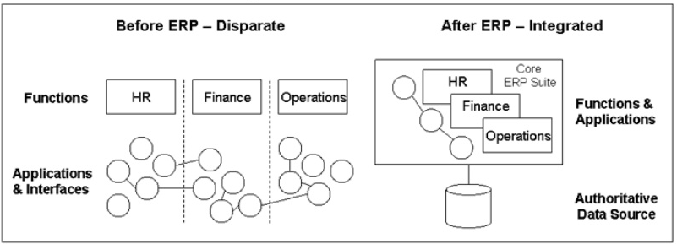
Before and After ERP

Slide 14
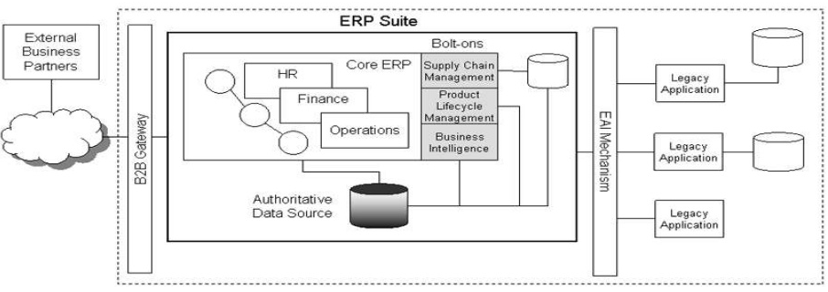
General Architecture

Slide 15
ERP Tiers
Tier 1: Multi Site, Multi National corporations 1000>
Tier 2: Medium size 100-999
Tier 3: Small or Single Site
Tier 4: Small Or Single Site with basic need only.

Slide 16
Assignment 1
Due Date: 22- Feb-2025
Q1- A brief Introduction to the modules in SAP and Dynamics 365.
Q2- List 3 vendors in each Tier of ERP.

Slide 17
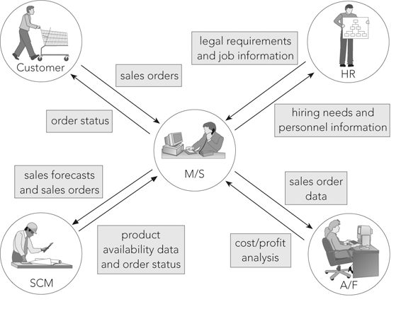
Functional Process
Marketing & Sales

Slide 18
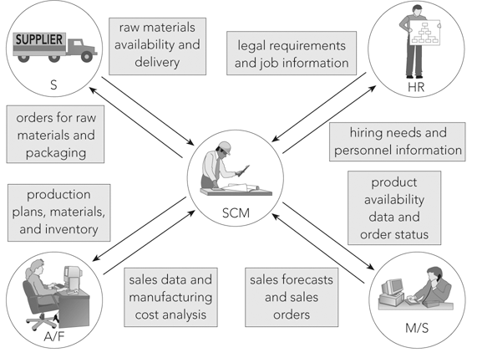
Supply Chain Management

Slide 19
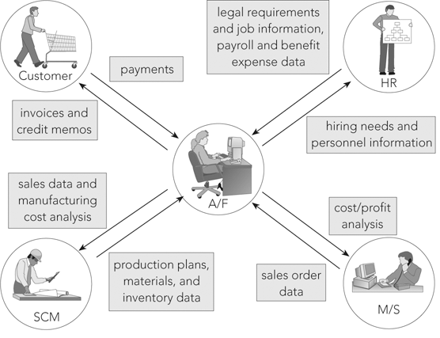
Accounting and Finance

Slide 20
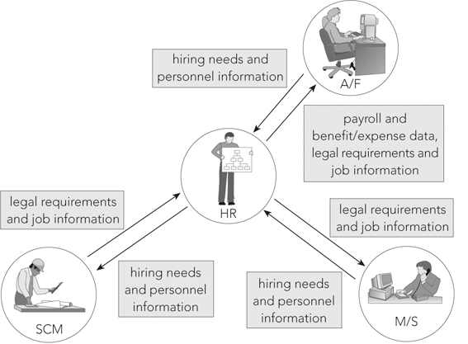
Human Resources

Slide 21
Process Map
A process map, also known as a cross-functional flowchart or swim lane diagrams, is used by many organizations seeking to document, analyze, streamline, and redesign business activities.

Slide 22
Process Map
Benefits:
Defining the “as is” business process and clarifying the changes necessary to transform the present process into the “to be” process.
Determining whether “as is” measures are appropriate.
Promoting awareness of employees’ responsibilities.
Showing the impact a certain role’s performance has on upstream and downstream activities in the process.
Highlighting workflow inefficiencies.
Identifying opportunities to streamline and improve processes.
Pinpointing internal controls that need to be tested during an audit.

Slide 23
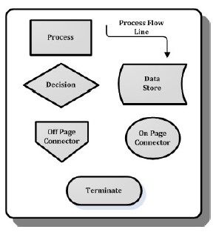
Process Map Symbols

Slide 24
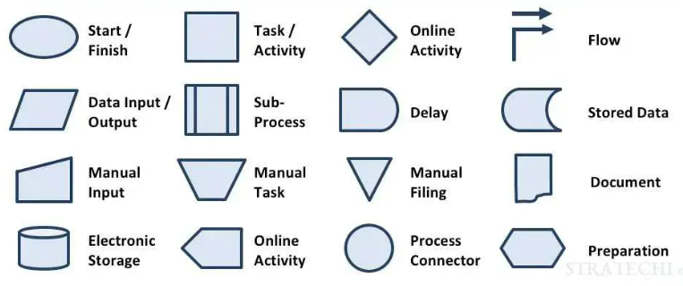
Process Map Symbols
Process map symbols
Process map symbols

Slide 25
